Slide 1

Norwegian experiences with renewable energy
in the district heating sector and industry
International training conference on RES, Gdansk 24-26 November 2015
Financed from Bilateral Cooperation Found EEA Financial Mechanism and Norwegian Financial Mechanism 2009-2014
within the PL04 Operational Programme „Energy saving and promoting renewable energy sources”
Hans Borchsenius
Principal consultant.
Norsk Energi
Hans.borchsenius@energi.no
www.energi.no
Tel +47 22 06 18 00
1

Slide 2
Norsk Energi
Industry association established in 1916
80 experts with BSc, MSc and PhD
Consultancy, engineering services, analysis and training
Independent from equipment suppliers and manufactures
90% of turnover from private industry and DH
10 % international projects funded by Norwegian government and International Finance Institutions

Slide 3
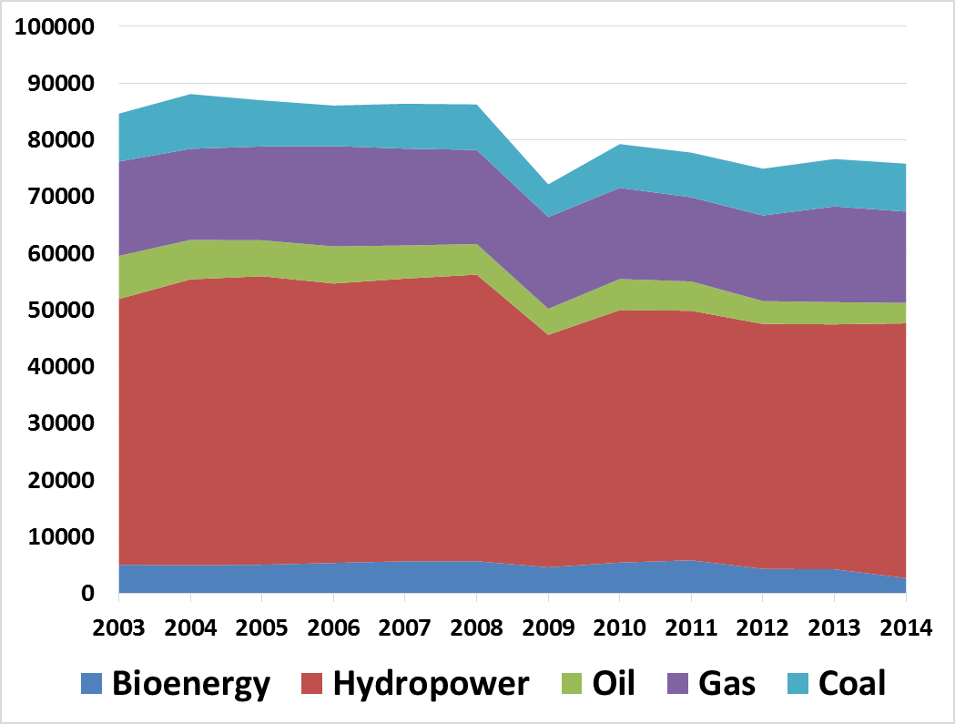
Energy consumption in industry
Oil, Gas & Coal
36,6 %
Renewable energy
63,4 %

Slide 4
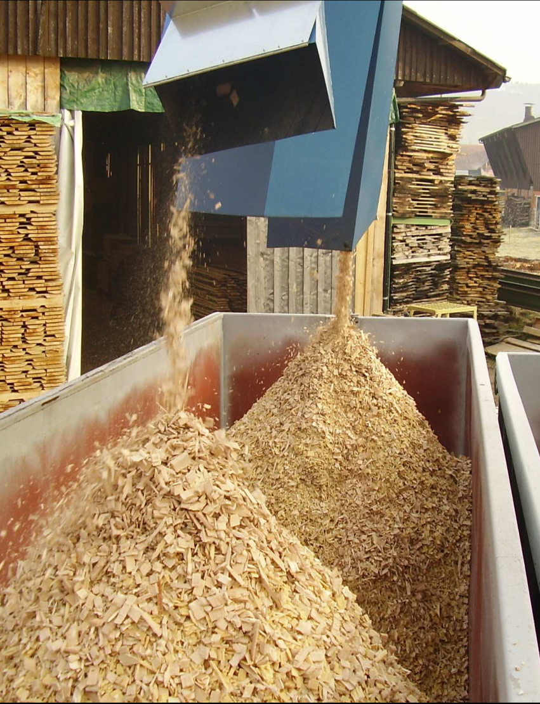
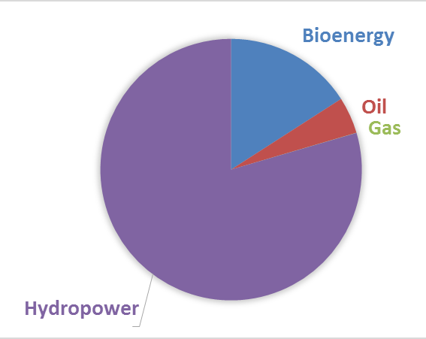
Pulp and paper industry high focus on utilisation of own wood resources
1900 – 1950 Coal
1950 – 1980 Heavy fuel oil
1980 → Bioenergy

Slide 5
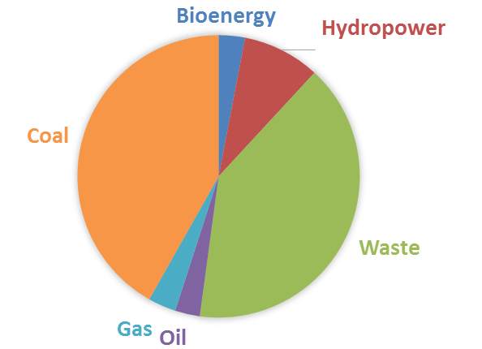
Cement Industry
Example: Norcem Brevik
High focus on CO2 reduction
Energy balance (%):
Bioenergy 3
Hydropower 9
Waste 40
Oil 3
Gas 3
Coal 42
Renewable 52
Fossil 48

Slide 6
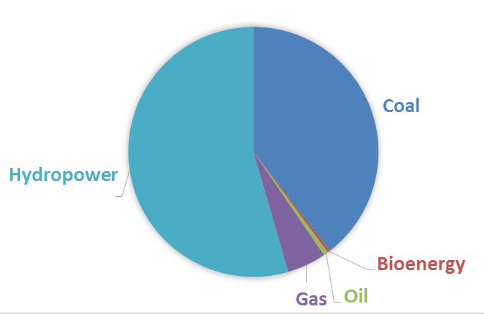
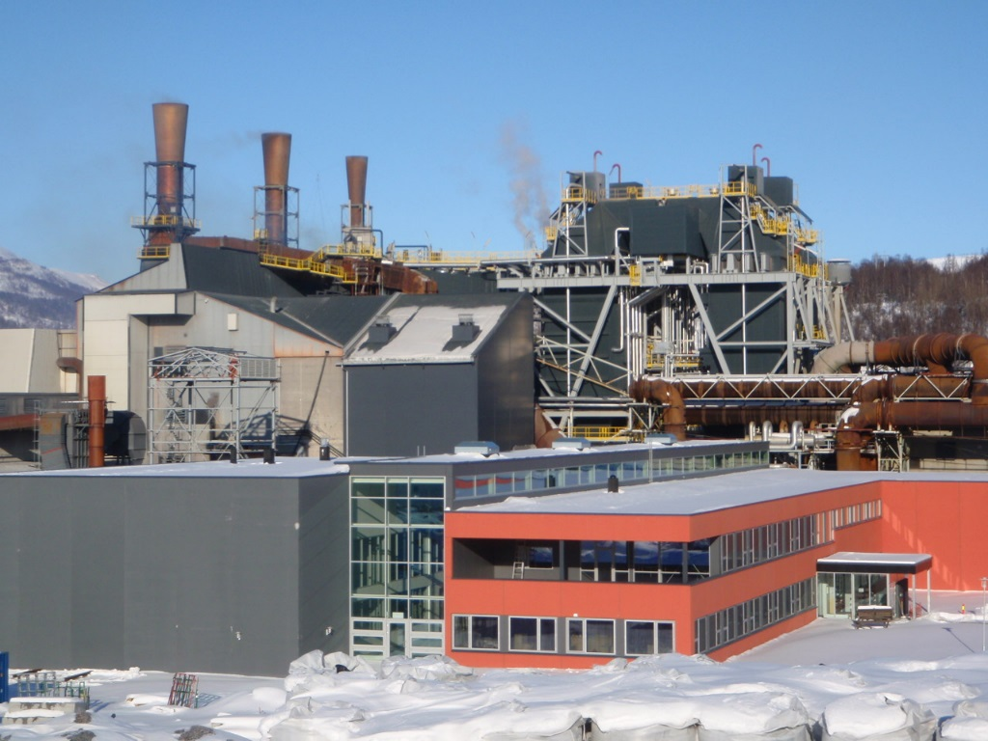
Ferroalloy industry
High focus on waste heat recovery

Slide 7
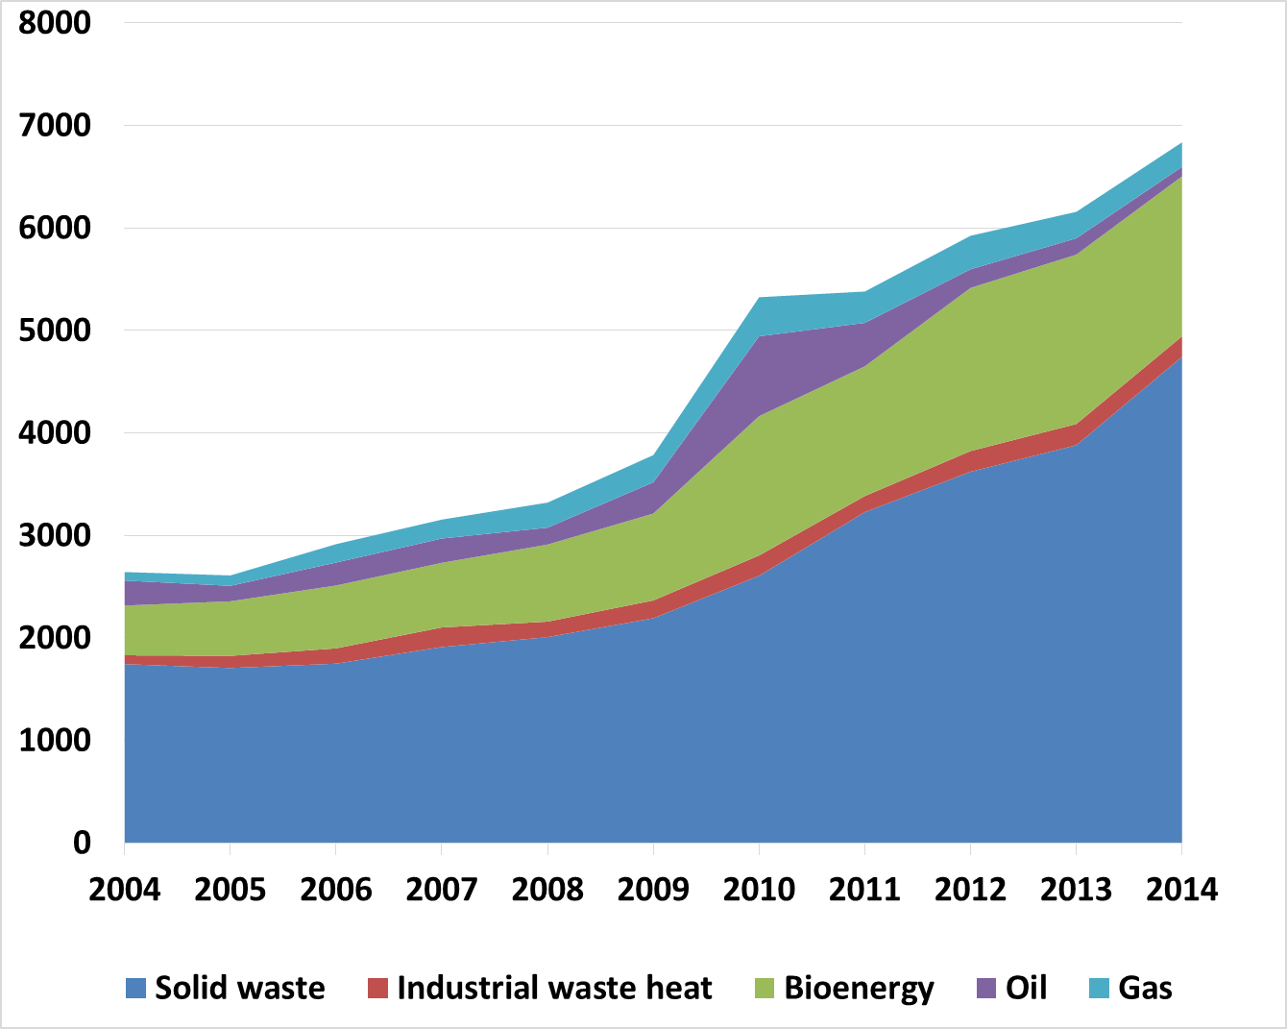
Energy consumption in district heating
Oil & Gas
4,3 %
Renewable energy
95,7 %

Slide 8
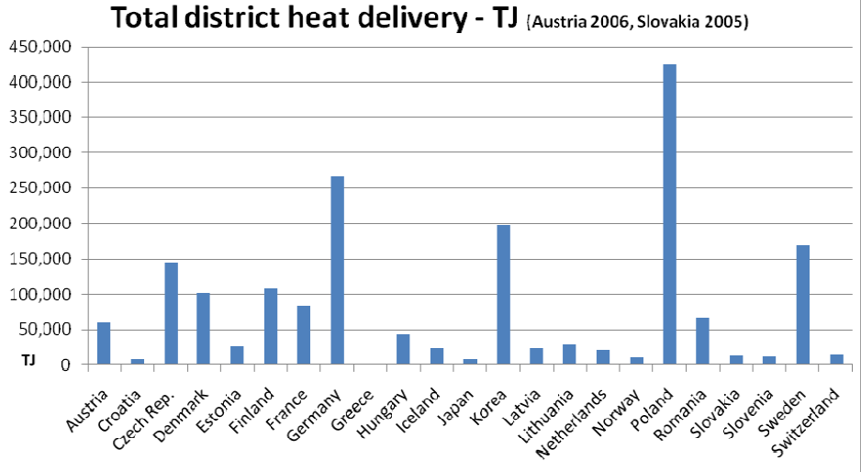
District heating in Europe

Slide 9
Primary energy supply to district heating in Norway and Poland
%

Slide 10
Share of renewable energy (%)
Depend on energy prices and weather conditions
Max 98,9 %
Min 76,3 %

Slide 11
Primary energy supply for district heating in 2014
The diagram shows country average.
But every city choose local solutions.

Slide 12
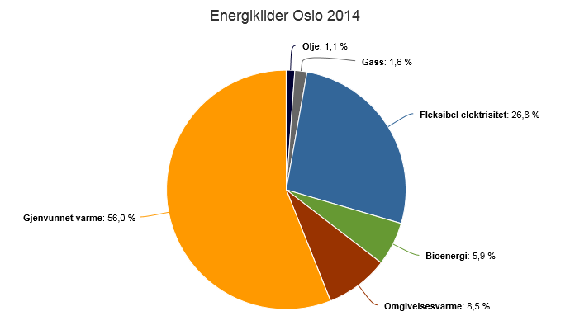
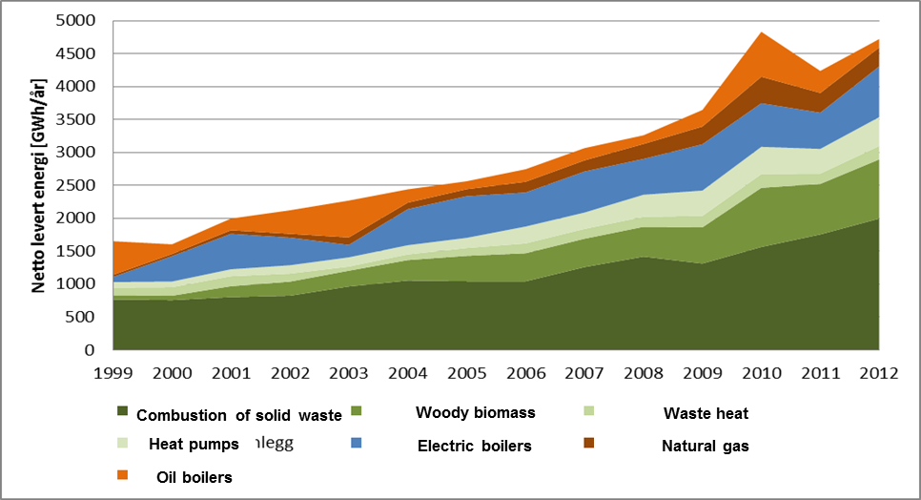
City: Oslo
Waste incineration, bio, heat pumps, El
Oil Gas
El
Waste
Bioenergy
Heat pumps

Slide 13
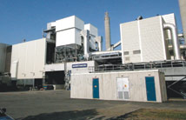
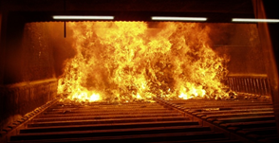
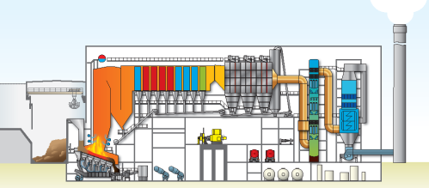
Klemetsrud Waste Management Plant
Combustion of
  household waste
  industrial waste
  landfill gas
Built in 1983/1986/2010
Annual capacity: 155.000 tonnes of waste
Annual production:
  70 GWh_{el}
  300 GWh_{t}

Slide 14
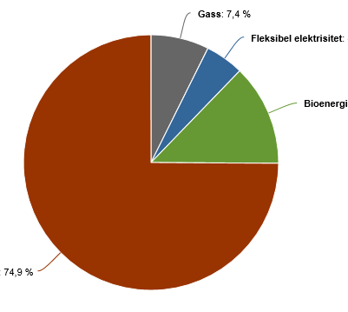
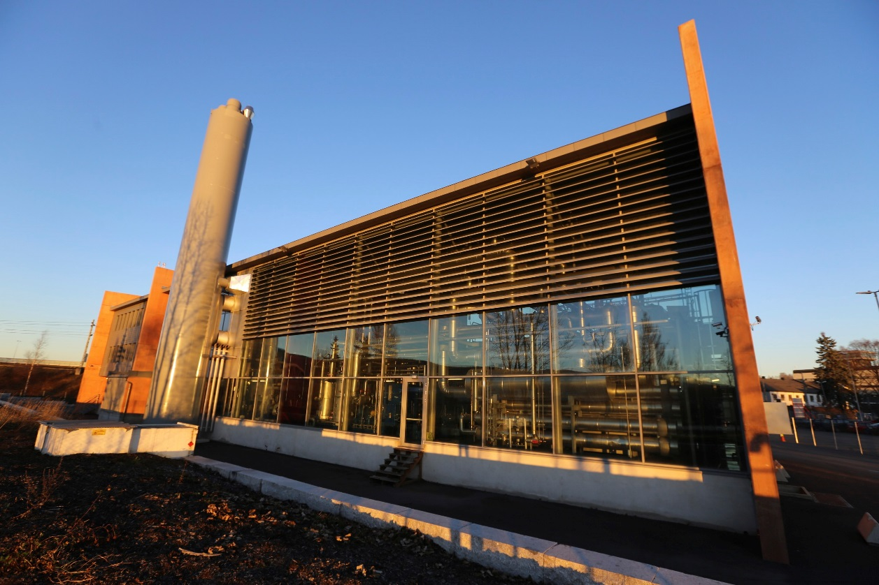
City: Drammen
Heat pump take heat from the sea
Sea water 8 → 90 degrees Centigrade
Largest ammonia hybrid heat pump in the world
Gas
El
Bioenergy
Heat pump

Slide 15
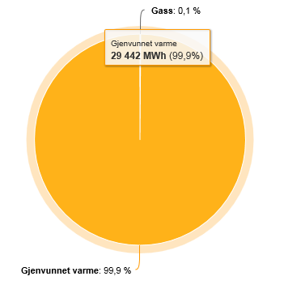
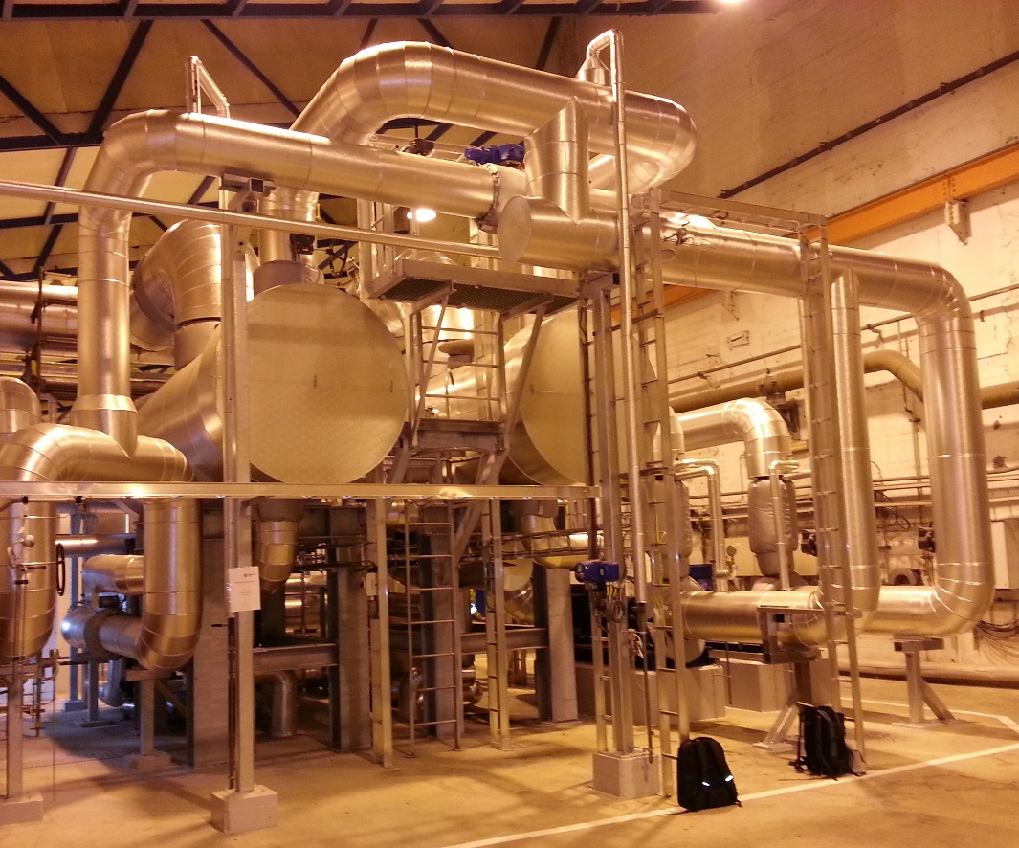
City: Porsgrunn
Industrial waste heat
99,9 % Waste heat from fertilizer production
0,1 % Gas
Gas
Industrial waste heat

Slide 16
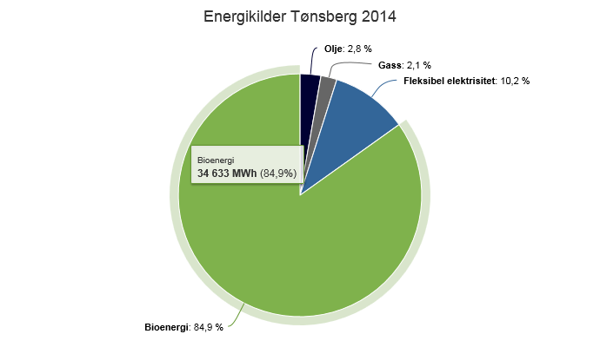
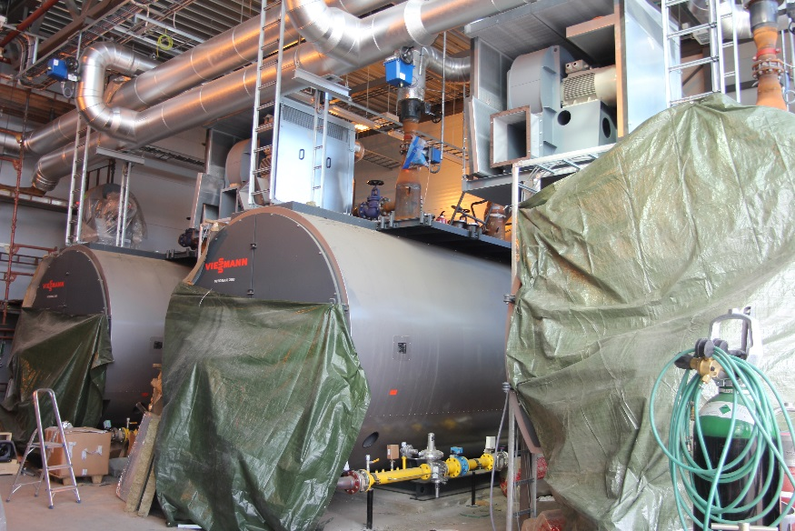
City: Tønsberg
45 MW woodchip boiler
El, oil and gas as peak load
Oil Gas El
Bioenergy

Slide 17
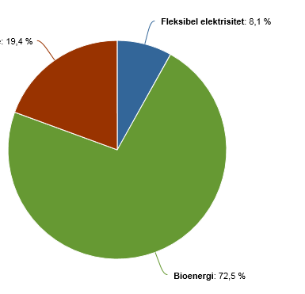
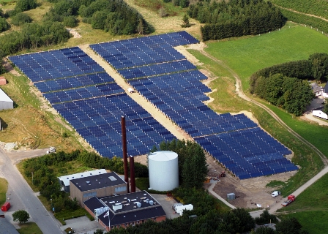
City: Lillestrøm
Bioenergy, Solar heat & heat pump
100 % renewable energy
El
Solar heat & heat pump
Bioenergy

Slide 18
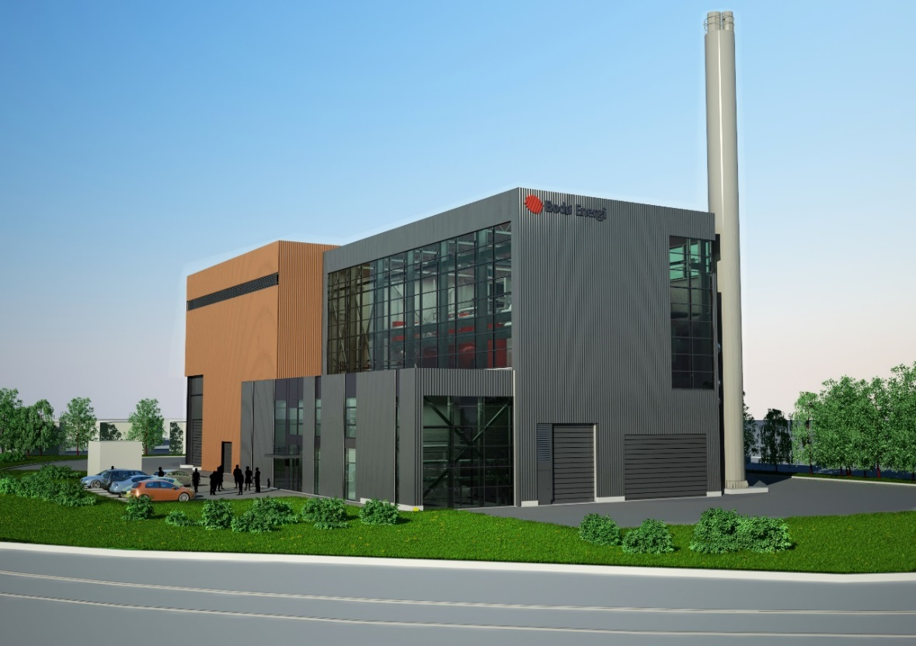
City: Bodø fuel: Demolition wood
23000 ton demolition wood fuel / year
2x10 MW gas boilers (LPG) as peak load
Heat production = 73 GWh / year

Slide 19
Low temperature district heating is important for max utilisation of renewable resourses
Development of district heating technology:
1880 First district heating systems introduced in the USA used steam
1930-1970 water > 100 degrees Centigrade
1980 Water 80 degrees Centigrade
2015 Water 40-50 degrees Centigrade
Advantages of low temperature systems:
Reduced heat loss in distribution networks
Possible to utilise low temperature heat sources, like waste heat from industry and buildings, surplus heat from cooling and freezing, solar heating, heat pumps that take heat from the sea, rivers, ground etc.

Slide 20
CONCLUSION
Norway has the highest share of renewable energy in Europe.
Why:
The electricity sector is almost 100 % based on hydropower
CO2 tax
EU emission trading scheme
Waste policy: Prohibited to put organic waste on landfills (EU waste directive 2009)
DH policy 1: Reduced electricity tax if renewables > 50 %
DH policy 2: Heat consumers may only chose DH or a more environmental friendly alternative.
State investment support to energy efficiency and renewable energy:
  Investment support only to environmental friendly projects
  Size of investment support is about 1 NOK/kWh RES (105 EUR/GWh)
Another reason is also the general public opinion: People WANT to be environmental friendly. The companies WANT to be better than the state regulations require to be attractive to customers.

