Slide 1
GREEN BUSINESS NORWAY
Biomass based energy plants
26.11.2015
International Training Conference
”Energy Saving and Promotion of Renewable Energy Sources”

Slide 2
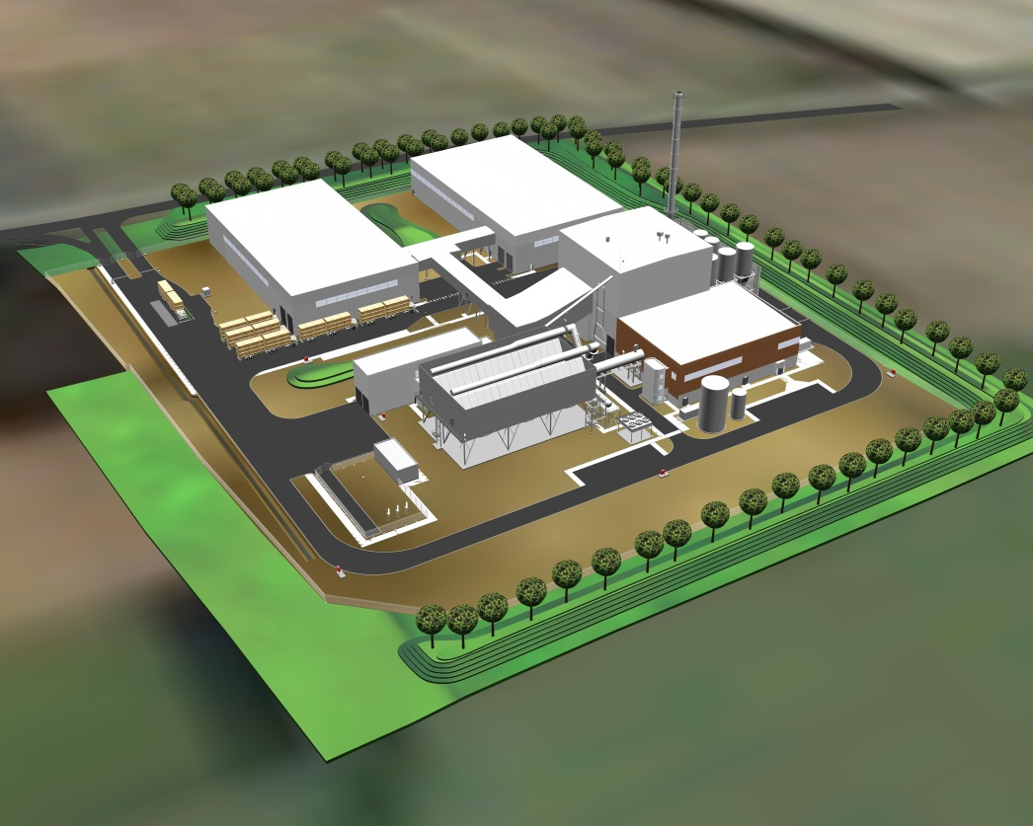
SLEAFORD 38,5 MW_{e}
1
9
10
1 Straw storage
1
2
8
2 Fuel conveyor
7
3 Woodchips storage
3
4 132 Kv switch
5
5 Air cooled condenser
6 Steam turbine
4
7 Control room
8 11-132 Kv transform.
9 Boiler house
10 Flue gas treatment

Slide 3
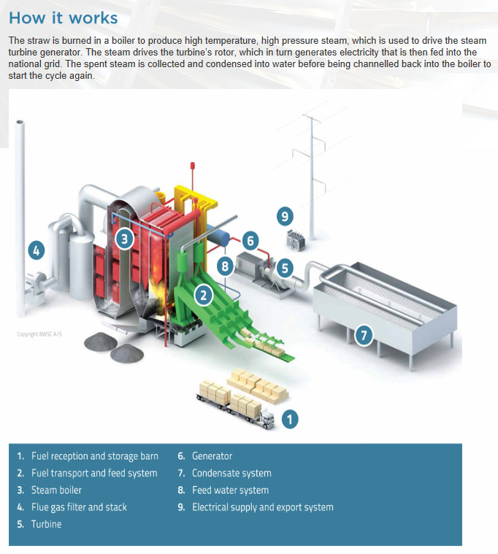
SLEAFORD 38,5 MW_{e}

Slide 4
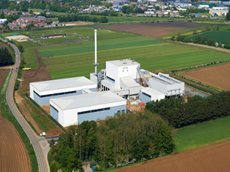
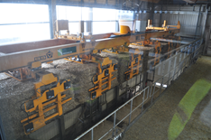
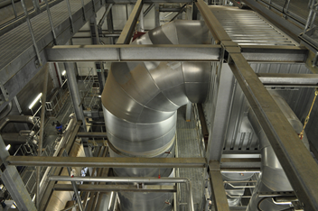
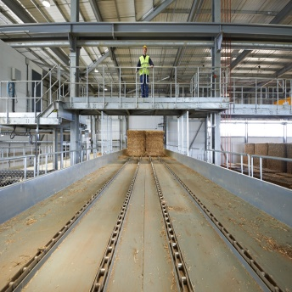
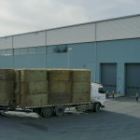
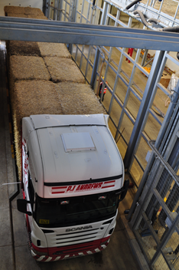
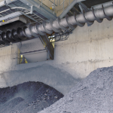
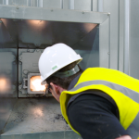
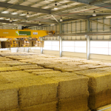
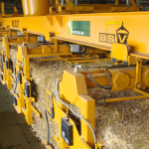
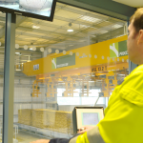
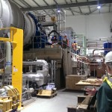
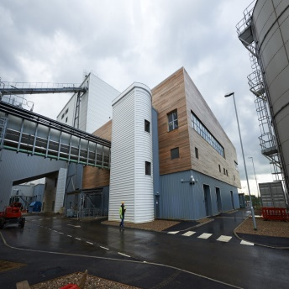
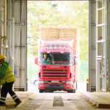
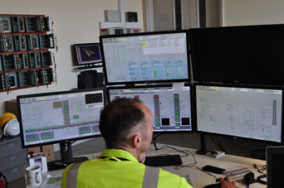
SLEAFORD 38,5 MW_{e}

Slide 5
SLEAFORD 38,5 MW_{e}
Alalyse
Job hazards
Best effeciency of delivery

Slide 6
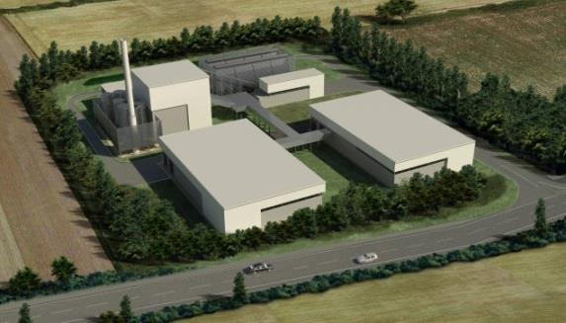
SLEAFORD 38,5 MW_{e}
38,5 MW_{e} renewable energy in base load operation
Output equivalent to Electrical consumption in 65,000 homes
2 MW Thermal Sustainable Heat for local community
230,000 tonnes CO₂ saved per year
Local straw contracts equating to ~ 1000 Heston bales processed per day ~ 500 Tonnes in weight
30 jobs in operation; 50 in fuel supply
Ash is recycled for fertiliser

Slide 7
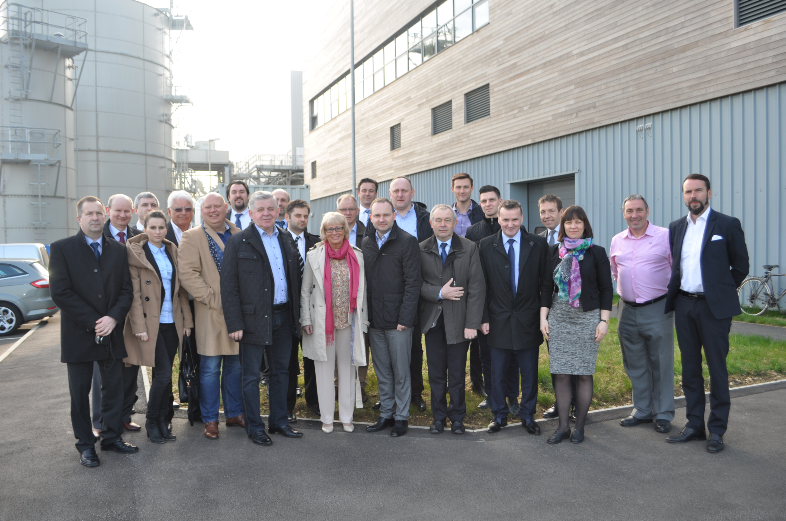
LUBELSKIE
75 MW_{e} from straw

Slide 8
TergoPower develops one medium-sized biomass fueled power plant in Lublin and one medium-sized biomass fueled combined heat & power plant
(CHP) in Biłgoraj
Biomass power plants stabilize
the Polish power grid and secures steady flow of electricity
Planned electricity sales:
Lublin – 390 GWh Biłgoraj – 190 GWh
Main fuel planned: Straw in bale form
Now at advanced development:
Construction start: 2016
Commissioning: 2018
LUBELSKIE

Slide 9
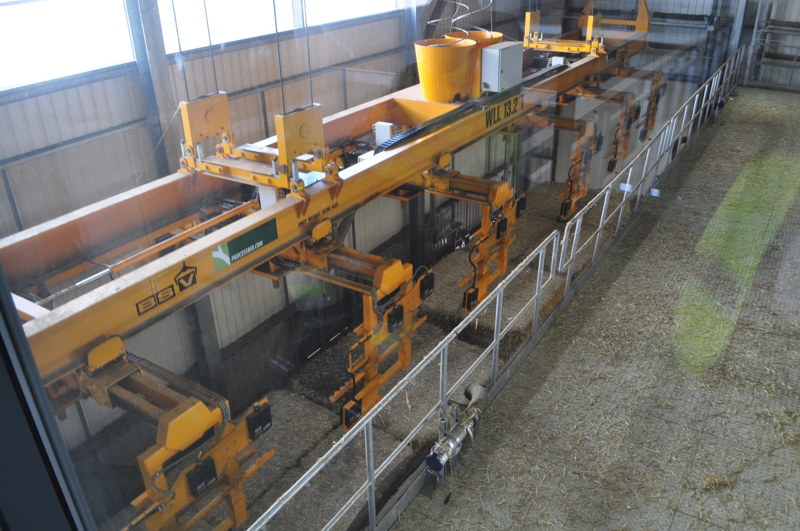
The 49.9 MWe power plant aim to enter commercial operation in 2018
The plant generates enough electricity to power more than 112,000 homes using sustainable fuel sources
The plant saves 200,000 tons of CO2 per annum, helping Poland achieve the renewable energy target and strengthen the nations energy security
The plant is highly beneficial for the local economy; increases farmers’ profit, creates up to 300 jobs during construction and will support more than 130 local jobs including 30 on-site operatives and 100 in the fuel supply chain
Clean and efficient combustion of straw secured from farms within the Lubelskie region. Ash produced by the plant will be recycled as crop fertilizer
Proven technology from a reputable turnkey supplier / High quality development (very experienced subcontractors) / strong performance guarantees for the plant’s operation
LUBLIN

Slide 10
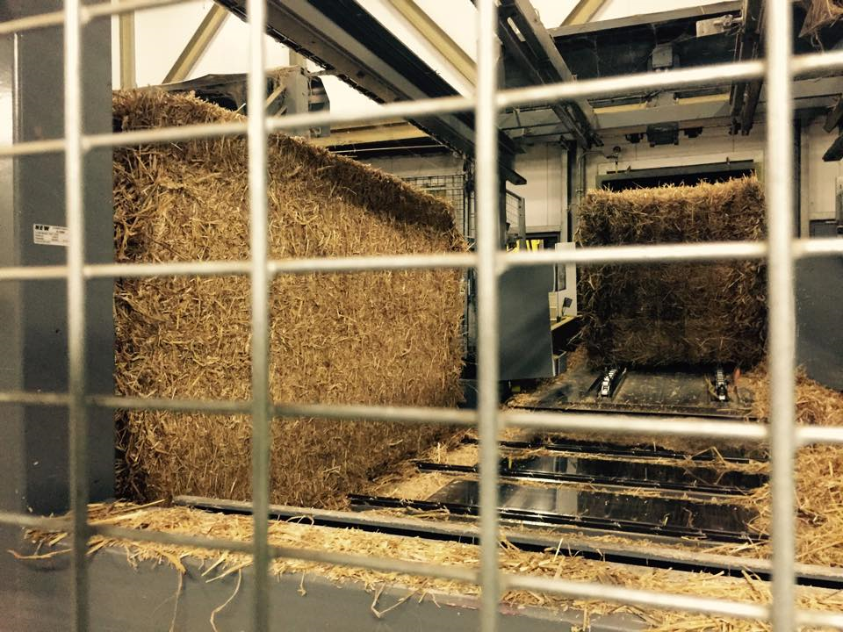
BIŁGORAJ
The 25 MWe and 25 MWth Biłgoraj plant aim to enter commercial operation in 2018 ➔ Shall replace an existing coal-fired power plant
(All employees will be offered work at the new plant)
Will generate enough electricity to power more than 57,000 homes using sustainable fuel sources
Saving 100,000 tons of CO₂ per annum
The plant is highly beneficial for the local economy; increases farmers’ profit, creates up to 250 jobs during construction and will support more than 100 local jobs including 30 on-site operatives and 70 in the fuel supply
Clean and efficient combustion of straw secured from farms within the Lubelskie region. Ash produced by the plant will be recycled as crop fertilizer

Slide 11
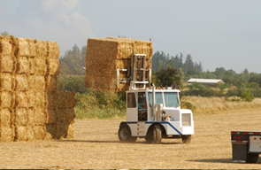
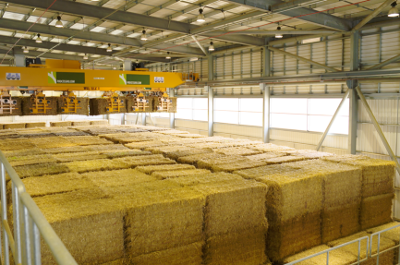
One of the key elements in the development of a straw-fired biomass power plant is the stability and predictability of fuel supplies over the entire operation period
A ton of straw is sufficient to generate ~ 1.4-1.5 MWh of electrical energy
The Lublin plant requires ~ 35 tons/h 280,000 tons per year
The Biłgoraj plant requires ~ 17 tons/h 140,000 tons per year
Long-term biomass supply contracts with Lubelskie farmers secured by strong aggregators
Transport via rail and road. Truck transport to the plant will not delay traffic significantly due to the new Lublin road ring
FUEL SUPPLY

Slide 12
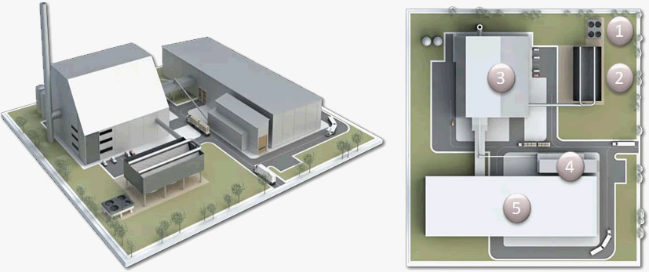
DESIGN
1. Aux. cooler
2. Air cooled condenser
3. Boiler, turbine and offices
4. Woodchip store
5. Straw barn

Slide 13
The modules are assembled and tailored according to fuel mix:
1. Fuel reception and storage barn
2. Fuel transport and feed system
3. Steam boiler
4. Flue gas filter and stack
5. Turbine
6. Generator
7. Condensate system
8. Feed water system
9. Electrical supply and export system
10. Optional wood chip fuel system
PROCESS

Slide 14
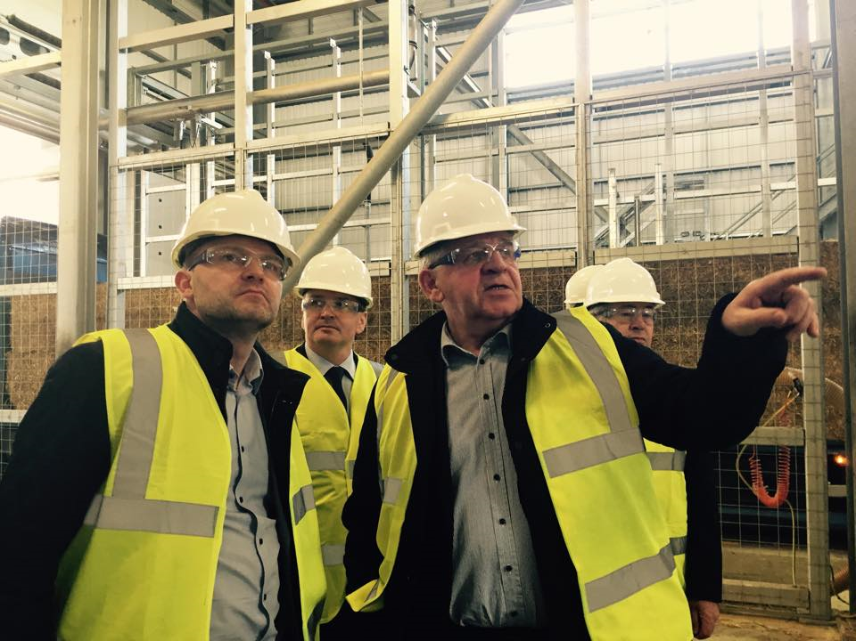
Lubelskie will become
THE LEADING RENEWABLE REGION IN POLAND
Many NEW JOBS
LONG-TERM biomass supply
CONTRACTS
with LUBELSKIE FARMERS
The two power plants combined save 300,000 TONS OF CO₂ /a
NO DISTURBING SMELL …
NO DISTURBING SOUND
TergoPower’s investment result with
GREENER and CLEANER
ENVIRONMENT
BENEFITS

Slide 15
GREEN BUSINESS NORWAY
Anna Larsson
anna@greenbusiness.no

